Slide 1
JAVA SCRIPT

Slide 2
CONSOLE.LOG
We will be using concole.log method to display the output in our upcoming lessons.
Its syntax:
Console.log(message);
Here message refers to variable or a value.

Slide 3
JAVA SCRIPT DATA TYPES
1)STRING
2)NUMBER
3)BOOLEAN
4)UNDEFINED
5)BIGINT
6)NULL
7)OBJECT
8)SYMBOL

Slide 4
IF STATEMENT
Syntax:
If(condition){
//body of the if }

Slide 5
IF …….ELSE
SYNTAX:
If(condition){
//body of if } else{
//body of else }

Slide 6
If…...elseif…..else
SYNTAX:
If(condition){ }
Elseif{ }
Else{
}

Slide 7
For ,while…SYNTAX
SYNTAX:
For(initialization;condition;update expression){
//body of loop }
SYNTAX:
While(condition){ //body of loop
}

Slide 8
SWITCH
Switch(value/expression){ case value1:
//body
Case value2:
//body
Default://body
}

Slide 9
Function syntax
Syntax 1:
Function nameofthefunction(){ //body of function;
}
Syntax2:
Function name(parameter1,parameter2){
//body of function}

Slide 10
OBJECT
JavaScript object is a non-primitive data-type that allows you to store multiple collections of data.
If you are familiar with other programming languages, JavaScript objects are a bit different. You do not need to create classes in order to create objects.
Syntax:
Const objectname={ key1:value1;
Key2:value2;}

Slide 11
ADDING PROPERTY,FUNCTION
Let student={} //creating object
Student.name=‘john’; //adding a property
Student.greet=function(){ console.log(“hello”)} //adding a method

Slide 12
ARRAYS
An array is an object that can store multiple values at once. For example,
1)Const words=[‘hello’,’hai’,’bye’];// creating array by using array literal.
2)const words=new array(“eat”,”sleep”);//creating array by new keyword.
we can also perform various methods to perform the task easier

Slide 13
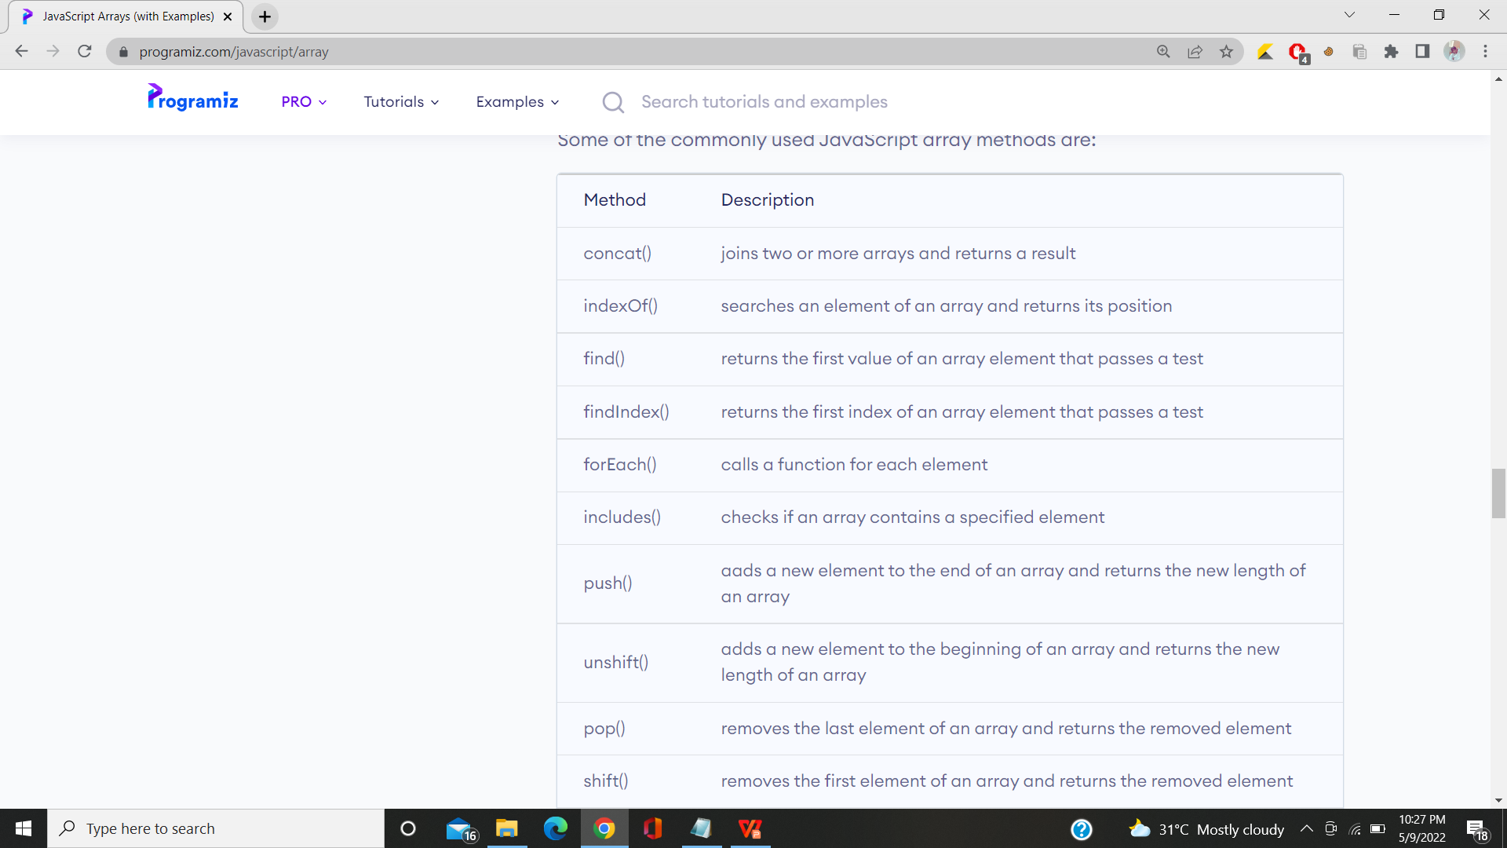

Slide 14
STRINGS
In JavaScript, strings are created by surrounding them with quotes. There are three ways you can use quotes.
Single quotes: 'Hello'
Double quotes: "Hello"
Backticks: `Hello`

Slide 15
STRINGS ARE IMMUTABLE
In JavaScript, strings are immutable. That means the characters of a string cannot be changed. For example,
let a = 'hello';
a[0] = 'H';
console.log(a); // "hello"

Slide 16
OTHER METHOD
let a = 'hello';
a = 'Hello';
console.log(a); // "Hello"

Slide 17
JAVA SCRIPT IS CASESENSITIVE
const a = 'a';
const b = 'A'
console.log(a === b); // false

Slide 18
OTHER METHODS
charAt(index) returns the character at the specified index
concat() joins two or more strings
replace() replaces a string with another string
toLowerCase() returns the passed string in lower case
toUpperCase() returns the passed string in upper case

Slide 19
other way to create string
const a = 'hello';
const b = new String('hello');
console.log(a); // "hello"
console.log(b); // "hello"
console.log(typeof a); // "string"
console.log(typeof b); // "object"

Slide 20
EXCEPTIONAL HANDING
TRY AND CATCH :
try {
// body of try
}
catch(error) {
// body of catch
}

Slide 21
EXAMPLE
const numerator= 100, denominator = 'a';
try {
console.log(numerator/denominator);
// forgot to define variable a
console.log(a);
}

Slide 22
CONTINUATION
catch(error) {
console.log('An error caught');
console.log('Error message: ' + error);
}

Slide 23
FINALLY
try {
// try_statements
}
catch(error) {
// catch_statements
}
finally() {
// codes that gets executed anyway
}

Slide 24
THROW WITH TRY AND CATCH
try {
// body of try
throw exception;
}
catch(error) {
// body of catch
}

